Slide 1
User Interface Design
What is user interface (UI)?
The user interface (UI) is the point of human-computer interaction and communication in a device. This can include display screens, keyboards, a mouse and the appearance of a desktop. It is also the way through which a user interacts with an application or a website.

Slide 2
Characteristics of a user interface
Speed of learning: A good user interface should be easy to learn and it should not require its users to memorize commands.
Attractiveness. A good user interface should be attractive to use. In this respect, graphics-based user interfaces have a definite advantage over text-based interfaces.

Slide 3
Characteristics of a user interface
Feedback. A good user interface must provide feedback to various user actions. Especially, if any user request takes more than few seconds to process, the user should be informed about the state of processing of his request.
Error recovery (undo facility). While issuing commands, even the expert users can commit errors. Therefore, a good user interface should allow a user to undo a mistake committed by him while using the interface.
User guidance and on-line help. Users seek guidance and on-line help when they either forget a command or are unaware of some features of the software. Whenever users need guidance or seek help from the system, they should be provided with the appropriate guidance and help.

Slide 4
Graphical User Interface vs. Text-based User Interface
In a GUI multiple windows with different information can simultaneously be displayed on the user screen. This is perhaps one of the biggest advantages of GUI over text-based interfaces.
Iconic information representation and symbolic information manipulation is possible in a GUI

Slide 5
A GUI usually supports command selection using an attractive and user-friendly menu selection system.
In a GUI, a pointing device such as a mouse or a light pen can be used for issuing commands. The use of a pointing device increases the efficacy issue procedure.
On the other hand, a text-based user interface can be implemented even on a cheap alphanumeric display terminal.
Graphics terminals are usually much more expensive than alphanumeric terminals.

Slide 6
Types of user interfaces
User interfaces can be classified into the following three categories:
Command language based interfaces
Menu-based interfaces
Direct manipulation interfaces

Slide 7
Command Language-based Interface
is based on designing a command language which the user can use to issue the commands.
The user is expected to frame the appropriate commands in the language and type them in appropriately whenever required.
Drawbacks:
Difficult to learn
Users make errors
All interactions with the system are through a key-board and cannot take advantage of effective interaction devices such as a mouse.

Slide 8
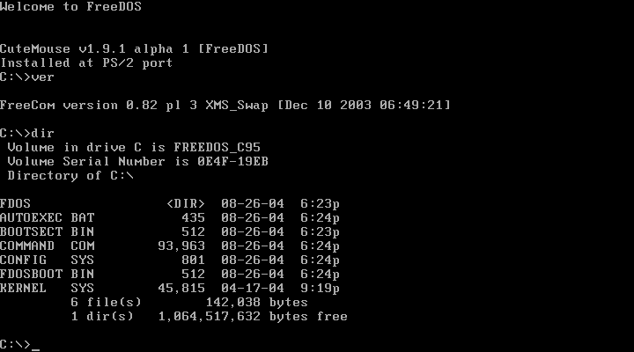

Slide 9
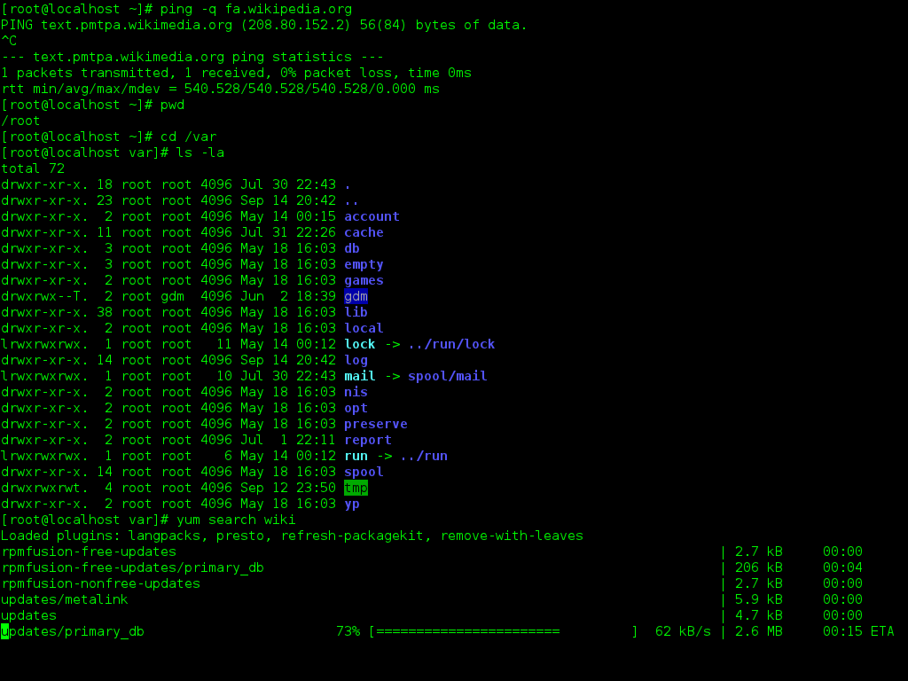

Slide 10
Menu-based Interface
An important advantage of a menu-based interface over a command language-based interface is that a menu-based interface does not require the users to remember the exact syntax of the commands.
A menu-based interface is based on recognition of the command names, rather than recollection.
Typing effort is minimal hence useful for the occasional user who can’t type fast.
Types of menu:
Scrolling menu
Walking Menu
Hierarchical Menu

Slide 11
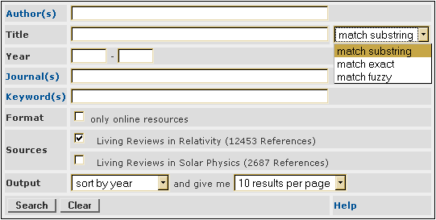
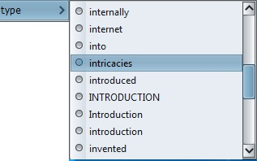
Scrolling Menu

Slide 12
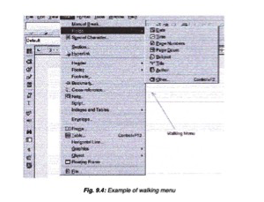
Walking Menu

Slide 13
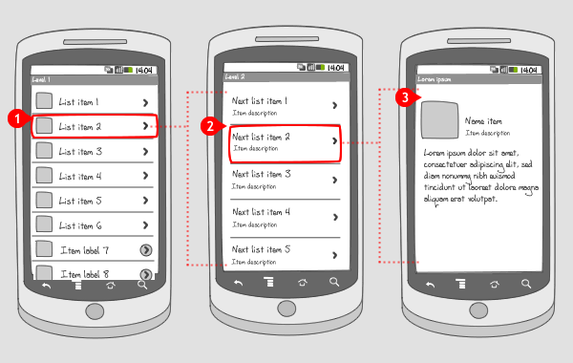
Hierarchical Menu

Slide 14
Direct Manipulation Interfaces
Direct manipulation interfaces present the interface to the user in the form of visual models (i.e. icons or objects).
For this reason, direct manipulation interfaces are sometimes called as iconic interface.
In this type of interface, the user issues commands by performing actions on the visual representations of the objects, e.g. pull an icon representing a file into an icon representing a trash box, for deleting the file.

Slide 15
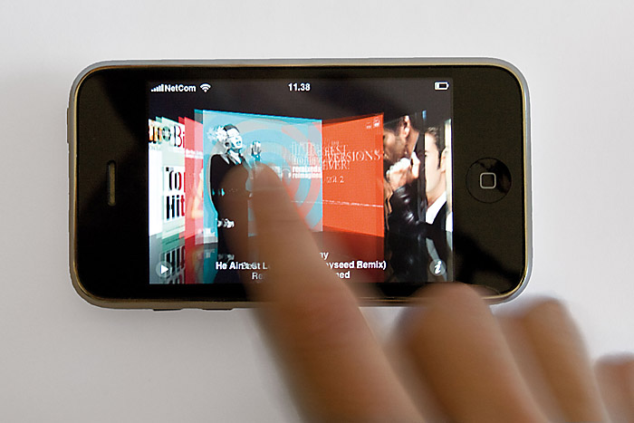
Examples

Slide 16
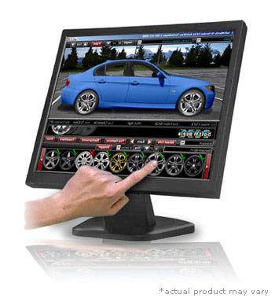
Examples

Slide 17
Important advantages of iconic interfaces include the fact that the icons can be recognized by the users very easily, and that icons are language-independent.

